Slide 1
An Occupational Safety and Health (OSH) assessment of Mining industry in Tamil Nadu Project - Batch No. 18
Project Member Details:
S.No. | Registration No. | Name of the Student | Project Mentor Details
1. | RA2011002010136 | Guvvala Tharun | Dr. VIGNESH K.S
2. | RA2011002010137 | Basith Shaik | Dr. VIGNESH K.S
3. | RA2011007010007 | Gururanga Ramanujam | Dr. MUTHAMIL SELVI P
4. | RA2011007010046 | Suraj Choudhary | Dr. VISHALI S

Slide 2
Introduction
Limestone mining in Tamil Nadu plays a vital role in the state's economy, providing essential materials for cement production, and other industrial applications, contributing around ₹640 cores to the state's GDP with a production capacity exceeding 25 million tones annually and employing over 50,000 individuals .
Despite its importance, inherent Occupational Safety and Health (OSH) risks threaten worker well-being.

Slide 3
This project addresses this concern by comprehensively assessing four key hazards – noise, vibration, silica dust, and VOCs – to identify risks, quantify exposure levels, evaluate existing control measures, and recommend actionable improvements. By safeguarding worker health and promoting safer practices, this project aims to ensure the industry's sustainable growth and development.

Slide 4
Motivation & Scope
Worker Safety: Identify and manage noise, dust, vibration, and potential VOC exposure risks to protect worker health.
Regulation Compliance: Ensure adherence to OSH regulations for noise, dust, and vibration exposure limits.
Comprehensive Assessment: Evaluate noise levels, dust composition and concentration, potential vibration exposure, and VOCs through air sampling.

Slide 5
Literature Review
S.No | Topic | Author | Method
1 | Propagation of Noise in Mines and Nearby Villages | Veena Dharmanand Manwar,Bibhuti Bhusana Manda | A Study Through Noise Mapping," offers a detailed exploration of the impact of mining activities on noise levels in both mining areas and the surrounding villages. Published in July 2016, the study employs noise mapping techniques to comprehensively assess and visualize the propagation of noise in these environments.
2 | A common occupational hazard in industrialized countries. | Heaver C, Goonetilleke KS, Ferguson H, Shiralkar S.. J Hand Surg Eur Vol. 2011;36(5):354–63. Epub 2011 Feb 10 | High-frequency vibration, such as that produced by certain drills, chisels, milling machines, saws, and cutting, sanding, and polishing machines, is largely absorbed by the fingers and hands and appears to be associated with the vascular and sensorineural symptoms of HAVS.
3 | Monitoring and Assessment of Airborne Respirable Dust and Free Silica Content in an Indian Mine | Priyanka Mankar (Indian Institute of Technology Kharagpur, India) , ( June 13 2019) | 24 dust samples were collected from the different areas of working in limestone mine during pre-monsoon and post monsoon seasons
4 | Environmental impact and health risk assessment, and control challenge analysis on industrial VOCs emissions from various industries. | Wang H L, Nie L, Li J, et al.,2013, aims to report the emission characteristics. | In this study a portable GC-MS is used for the on-line monitoring and determination of individual VOCs components.

Slide 6
Literature Review
S.No | Topic | Author | Method
5 | Effectiveness of controls for respirable crystalline silica dust exposure in construction: A literature review | Prisca Tente1, Erastus Misheng’u Mwanaumo1,2 and Wellington D. Thwala2 1University of Zambia | This study examines the hazards of silica dust and chemical irritants in construction materials. Wet materials produce skin irritants, while dry ones generate silica dust during construction activities. Most sites use a combination of water and dust masks (52%) for dust control, followed by dust masks alone (24%). Only 10% use water alone, and 5% have no control measures. Research primarily focuses on controlling silica exposure from on-tool activities like grinding and cutting.
6 | Distribution of VOCs in urban and rural atmospheres of subtropical India: Temporal variation, source attribution, ratios, OFP and risk assessment. | Amit Kumar, Deepak Singh, Krishan Kumar, Braj Bihari Singh, Vinod Kumar Jain. | This study in Delhi analyzed seasonal and daily variations, sources, ozone impact, and health risks of volatile organic compounds (VOCs). Urban areas had higher VOC levels, influenced by traffic and industrial emissions. Winter showed peak concentrations. Toluene and m/p-xylene were major urban ozone contributors, while toluene dominated rural areas. Health risks exceeded safety standards, suggesting significant hazards for the population.

Slide 7
Research Gap
Focus on Specific Hazards: Existing research might have addressed individual hazards like noise or dust exposure in other industrial environment, but a comprehensive assessment encompassing all four focus areas (noise, vibration, silica dust, VOCs) in Limestone mining is lacking.
Lack of Recent Data: OSH studies and data in the Lime stone mining industry, particularly in India, might not be readily available or updated regularly. This could create a gap in understanding current risk factors and their prevalence.

Slide 8
Research Gap
Limited Local Studies: Studies specifically focused on the Tamil Nadu limestone mining industry and its unique OSH challenges might be scarce. Research from other regions or mining types might not fully translate to the specific context of Tamil Nadu.

Slide 9
Objectives of the work
To assess the Occupational Safety and Health (OSH) risks faced by workers in limestone mines in Tamil Nadu, focusing on four key hazards: noise, vibration, silica dust, and volatile organic compounds (VOCs).
To determine the extend and impact these hazards in the surrounding environment .
Suggest effective control measures in mitigating exposure.

Slide 10
Multidisciplinary approach- Methodology adopted
Occupational Health and Safety
Physical Hazard
Chemical Hazard
Noise, Heat
Mechanical Hazard
Dust
VOC
Vibration
Area
Personal
Area
Personal
Area
Personal
Area

Slide 11
Roles & Technical Contribution of each Project Member:
S.No | Student Name | Department | Contribution
1 | Guvvala Tharun | Mechanical Engineering | Monitored the noise levels in terms of area and personal noise sampling based on the intensity of HEMM Operations in the mines.
2 | Basith Shaik | Mechanical Engineering | Evaluated the whole-body and hand- arm vibration which has harmful effects on the health of those Employed and occupational diseases in the opencast mines.
3 | Suraj Choudhary | Chemical Engineering | Assessed the air borne dust of workplace in terms of area and personal dust sampling and analyses the free Silica of dust in the collected samples.
4 | Gururanga Ramanujam | Chemical Engineering | Conducted preliminary study of the workplace and its environment that governs in identifying specific Sources of VOC emissions, quantifying concentration levels in various operational areas.

Slide 12
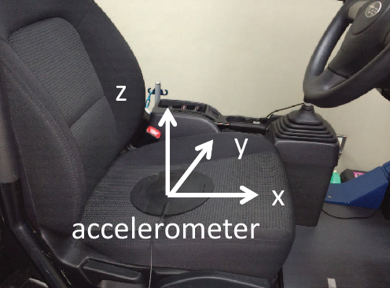
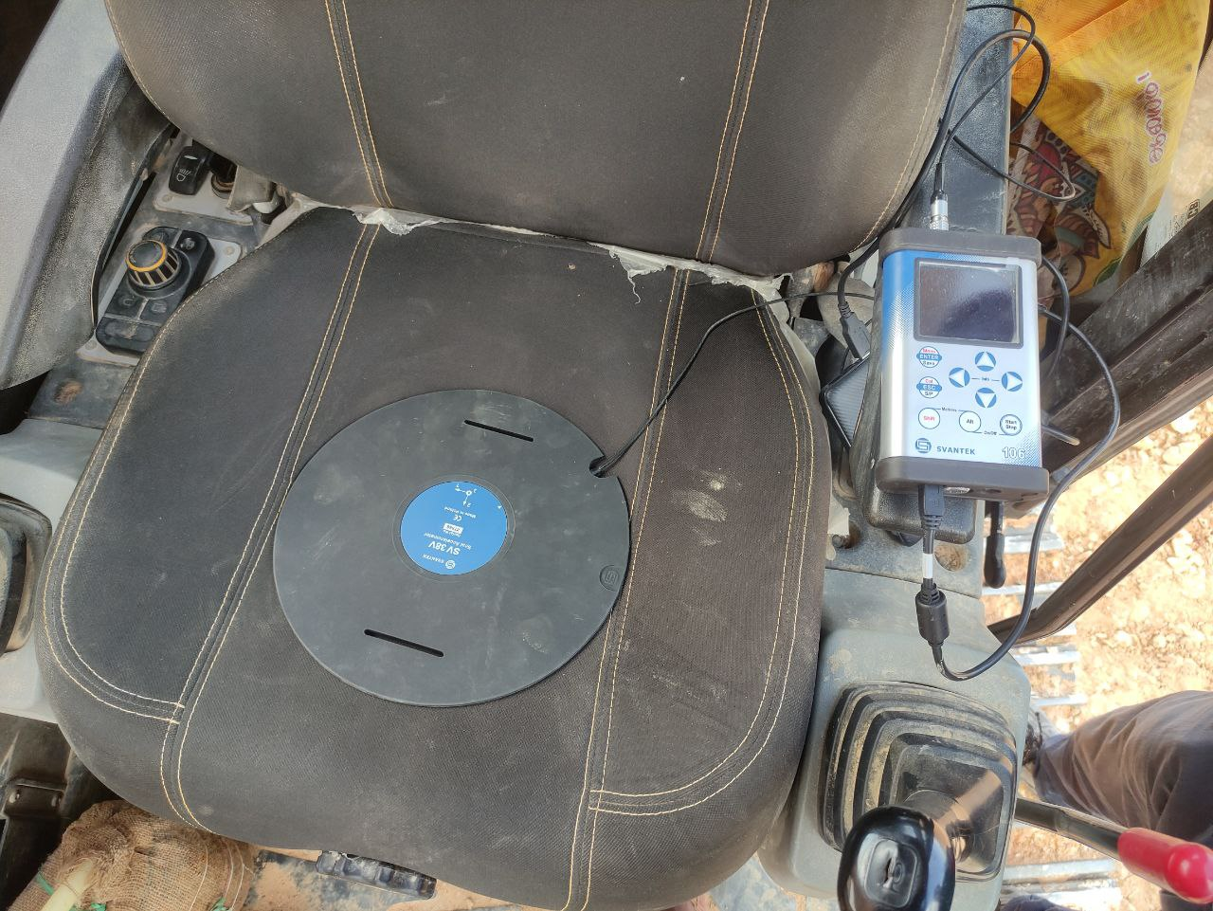
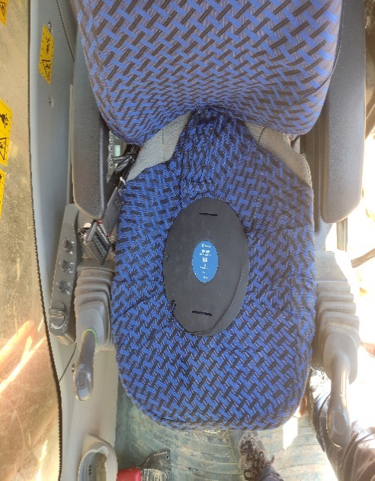
Experimental Work/ Analysis carried out
Image 1.1
Image 1.2
Image 1.3
Tri axial Pad

Slide 13
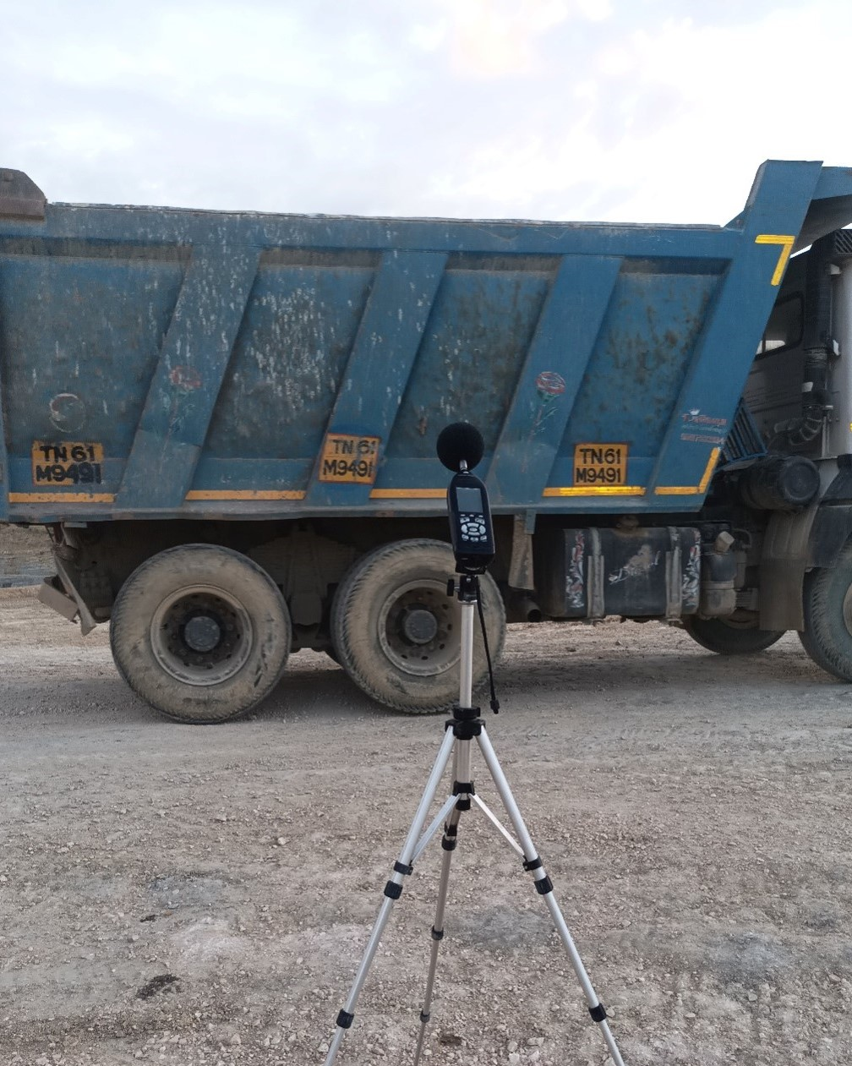
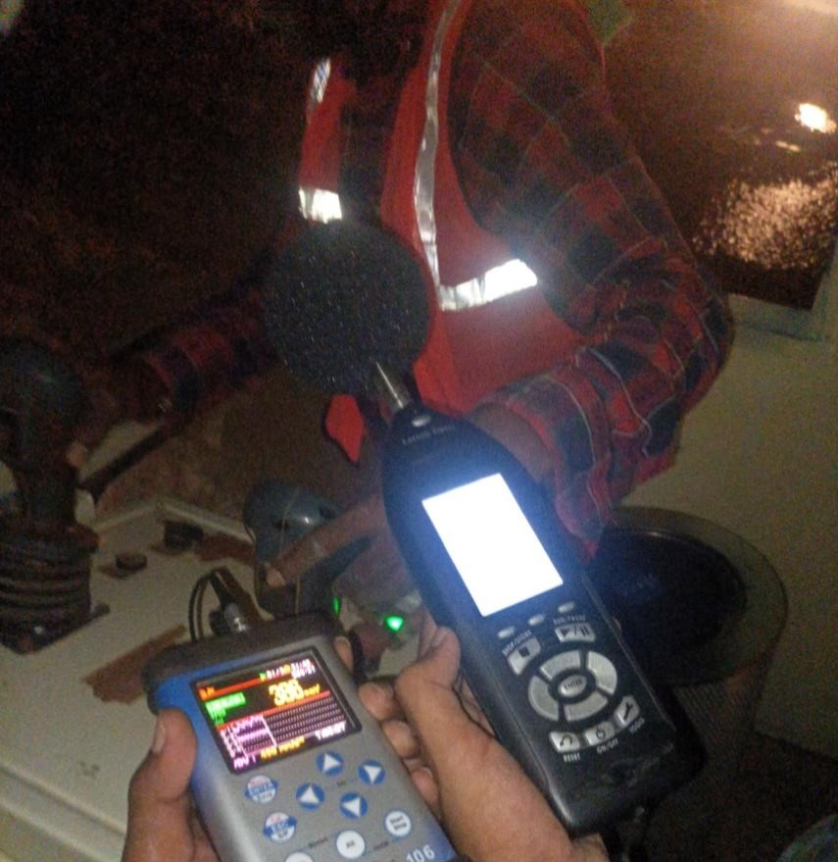
Image 3.1
Noise measuring Instrument

Slide 14
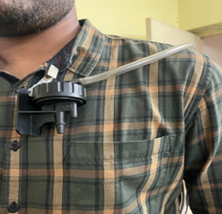

Image 2.1
Dust measuring Instrument
(Sidekick Pump)

Slide 15
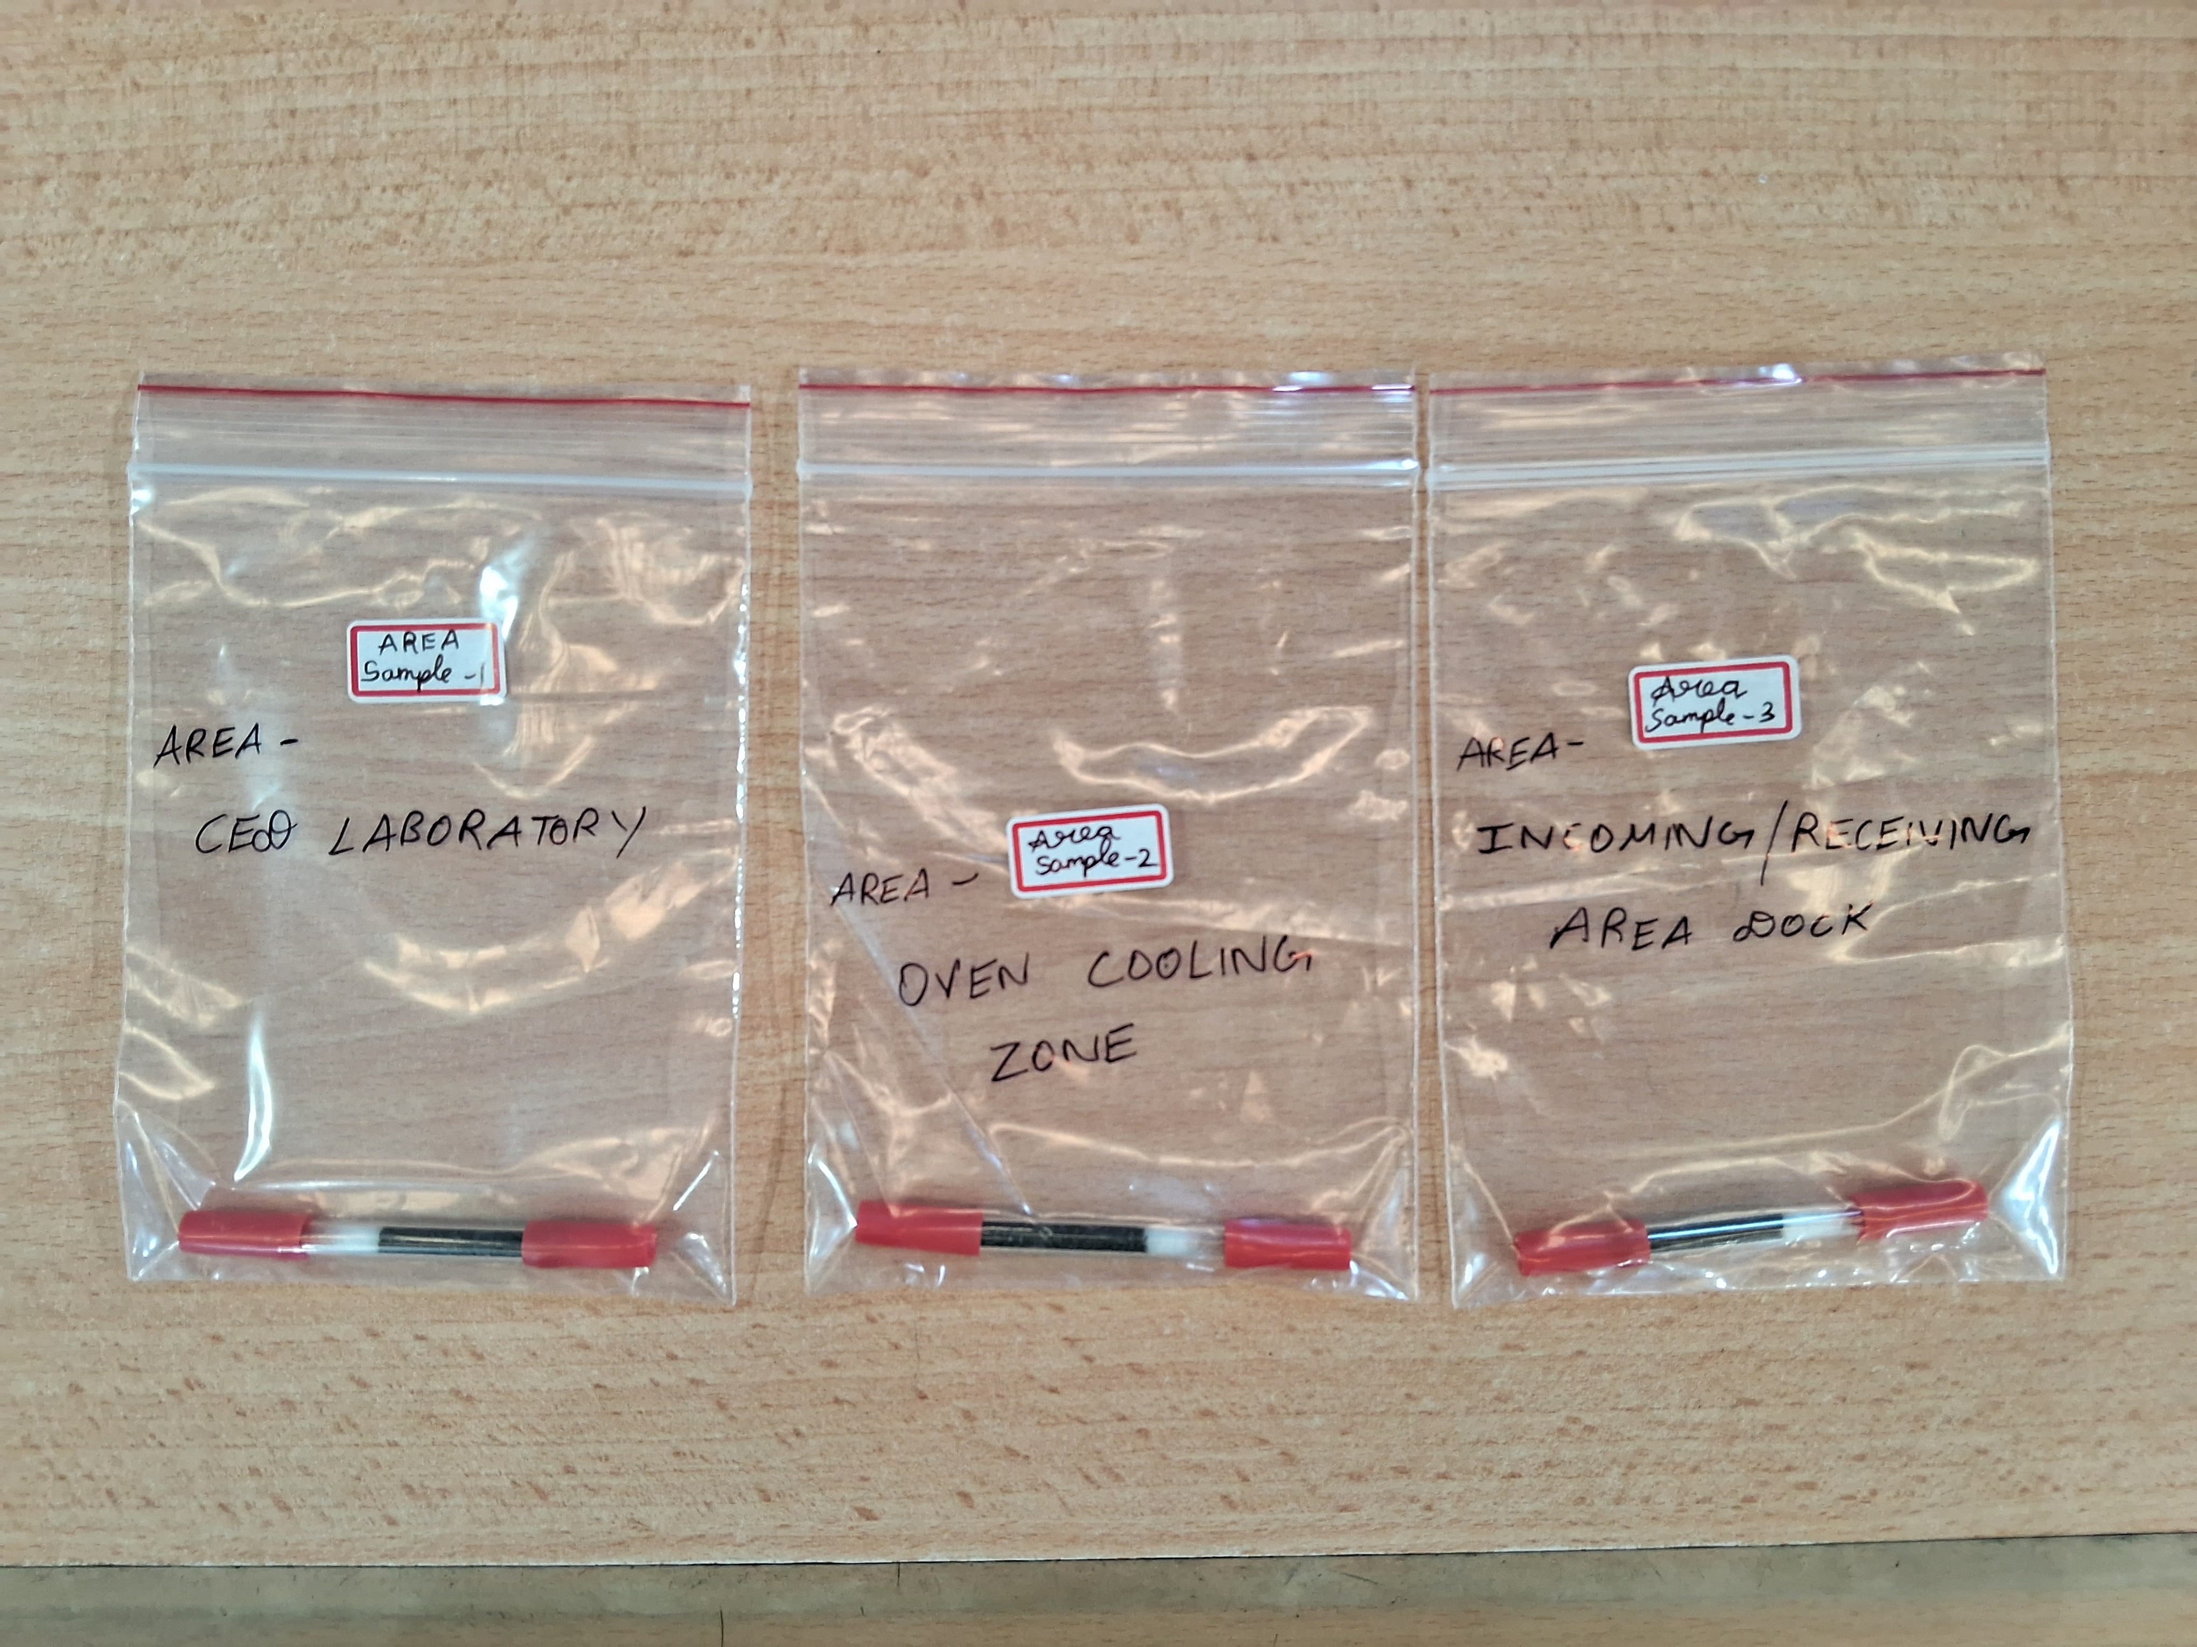
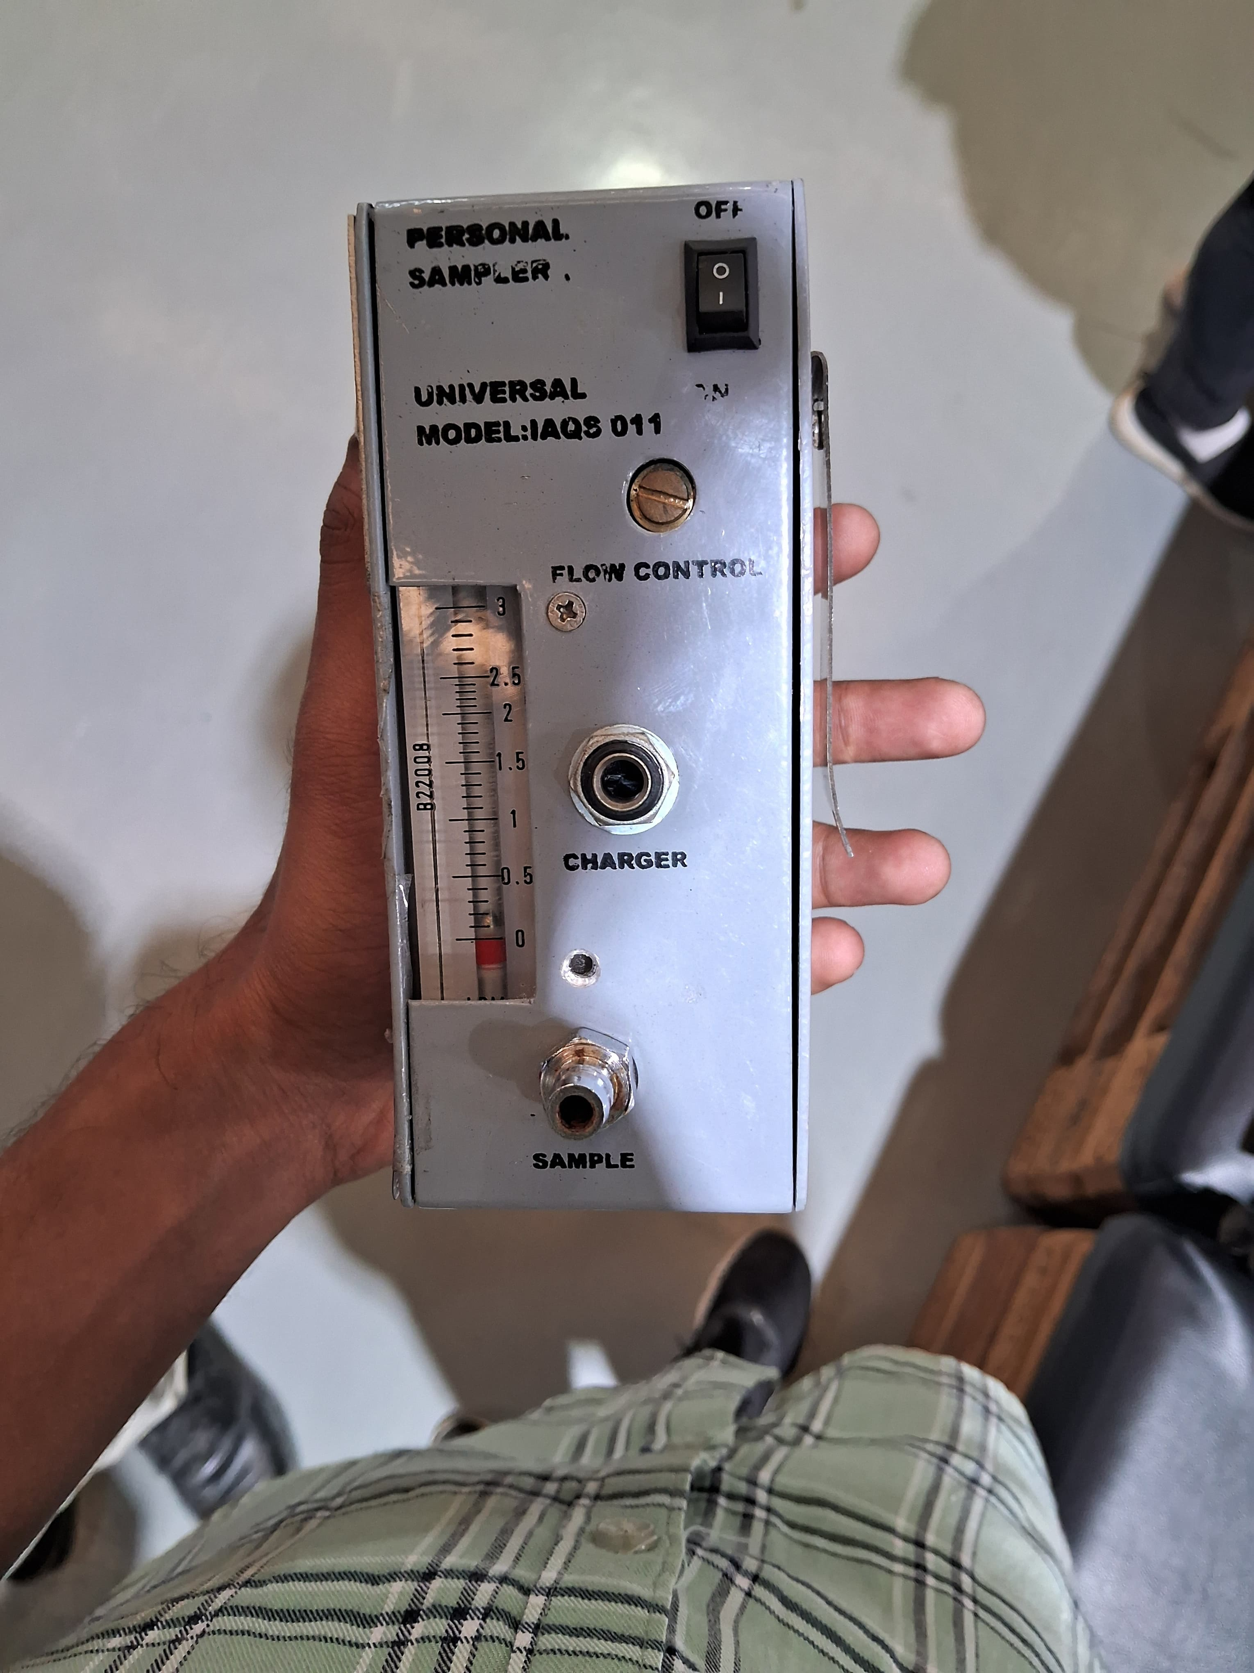
Image 4.1
Sorbent Tubes
Image 4.2
Gas Sampler

Slide 16
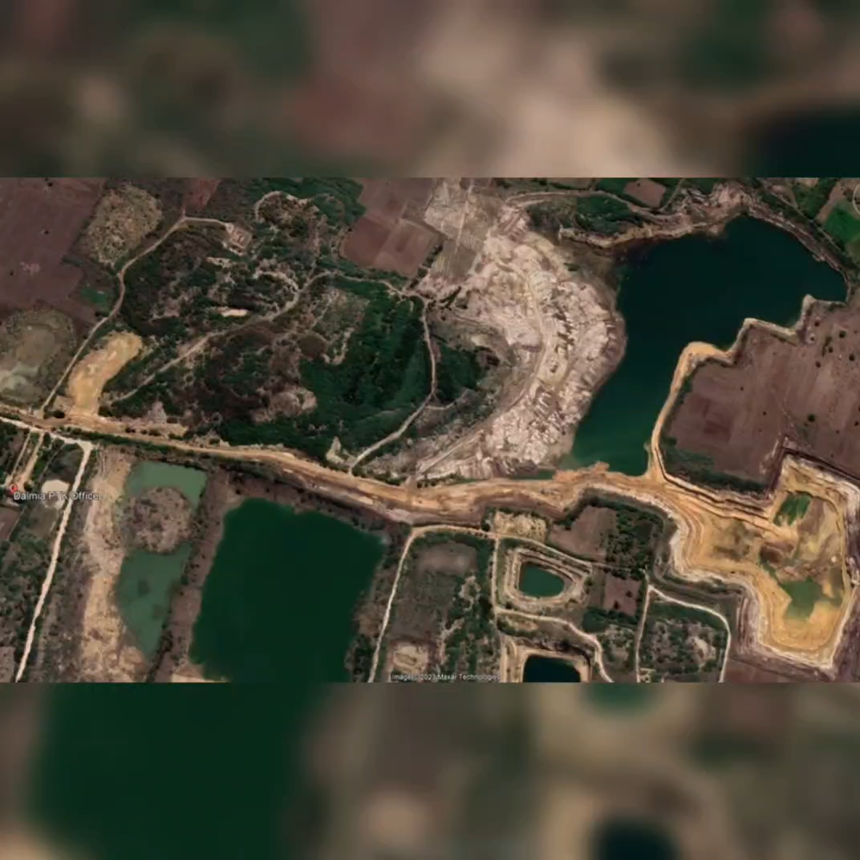
Demonstrations videos (if any)

Slide 17
Result and Analysis
Table 3.1
SL.NO | Noise Sample ID | Noise Sample locations | Date | L eq dB(A) | L max dB(A) | L min dB(A) | L peak dB(A) | TWA dB(A)
1 | LxT_Data.201.s | Taurus Tipper 10 wheel | 15.09.2023 | 102.9 | 124.8 | 86.3 | 132.9 | 102.1
2 | LxT_Data.205.s | Excavator(SK 380 XD) | 15.09.2023 | 103.5 | 133.4 | 71.9 | 141.3 | 98.4
3 | LxT_Data.206.s | Rock breaker(SK 520XD ) | 15.09.2023 | 109.0 | 137.0 | 72.2 | 144.0 | 106.7
4 | LxT_Data.207.s | Rock breaker(L&T) | 15.09.2023 | 106.9 | 135.4 | 81.1 | 143.6 | 104.2
Noise
Graph 3.1

Slide 18
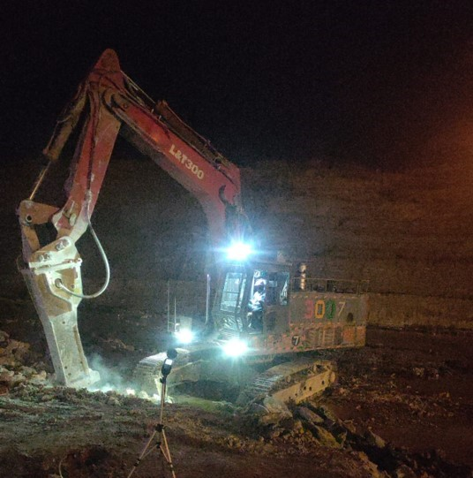
Personal Noise Analysis
Leq values provide the equivalent continuous noise level, which is a measure of the average noise level over the measurement period. Based on the data, all the Leq values are above 85 dB (A), which is higher than the recommended limit.
This indicates that the workplace is not in compliance with the acceptable noise exposure levels
The personal noise exposure levels of individuals, as indicated by the TWA values, for the entire shift are above the danger limit 90 dB(A). This suggests that there is a potential risk to the hearing health of employees.

Slide 19
Table 3.2
SL.NO | Noise Area Sample ID | SOURCE/ OPERATION | SAMPLING LOCATION | L min dB(A) | L max dB(A) | L eq dB(A) | L peak dB(A)
1 | LxT_Data.204.s | Front Wheel Loader | 10.9839387 | 88.5 | 105.7 | 69.9 | 115.2
 |  |  | 78.9473856
2 | LxT_Data.203.s | In Between the Excavator and Rock Breaker | 10.9766198 | 105.6 | 133.9 | 57.4 | 141.5
 |  |  | 78.9470321
3 | LxT_Data.202.s | Haul Road | 10.9780501 | 85.0 | 106.2 | 70.2 | 112.5
 |  |  | 78.9480926
Noise
Graph 3.2

Slide 20
Vibration
Table 4.1
Axis | Taurus Tipper 10 Wheel | Dozer(KCPL)D50 | Rock Breaker (CK-300) | Front wheel loader | Excavator (Sk 380xd) | KSM304(surface minner)
X | 0.002 | 0.0006 | 0.00007 | 0.322 | 0.784 | 1.354
Y | 0.0004 | 0.0007 | 0.0002 | 0.0009 | 0.001 | 0.0001
Z | 0.00003 | 0.0002 | 0.00003 | 0.0003 | 0.0003 | 0.00007
Table 4.2
Axis | Taurus Tipper 10 Wheel | Dozer(KCPL)D50 | Rock Breaker (CK-300) | Front wheel loader | Excavator (Sk 380xd) | KSM304(surface minner)
X | 0.18 | 0.098 | 0.01 | 11.245 | 19.981 | 40.581
Y | 0.094 | 0.099 | 0.095 | 0.107 | 0.123 | 0.094
Z | 0.067 | 0.067 | 0.067 | 0.068 | 0.069 | 0.067

Slide 21
Graph 4.1 (a)
Graph 4.2 (a)
Graph 4.1 (b)
Graph 4.2 (b)

Slide 22
Table 3.2
Risk assessment for vibration exposure using RMS acceleration
SL.NO | Equipment and Operator | Axis | A_{RMS} m/s² | Adjustment A(8) m/s2 | Exposure Duration (hour) | Maximum Vibration Exposure m/s2 | Health Risk Exposure
1 | Taurus Tipper 10 Wheel Loganathan | X | 0.002 | 0.002 | 8 | 0.002 in X Axis | Below the Exosure Action Value
 |  | Y | 0.0003 | 0.0004
 |  | Z | 0.00003 | 0.00003
2 | Dozer(KCPL)D50 Rajkumar | X | 0.0005 | 0.0006 | 8 | 0.0007 in Y Axis | Below the Exosure Action Value
 |  | Y | 0.0005 | 0.0007
 |  | Z | 0.0002 | 0.0002
3 | Rock Breaker (CK-300) Iyappan | X | 0.00005 | 0.00007 | 8 | 0.0002 in Y Axis | Below the Exosure Action Value
 |  | Y | 0.0001 | 0.0002
 |  | Z | 0.00003 | 0.00003
4 | Front wheel loader Ram devjadav | X | 0.23 | 0.322 | 8 | 0.322 in X Axis | Below the Exosure Action Value
 |  | Y | 0.0007 | 0.0009
 |  | Z | 0.0003 | 0.0003
5 | Excavator (Sk 380xd) Thirumalai | X | 0.56 | 0.784 | 8 | 0.784 in X Axis | Exposure Action Value
 |  | Y | 0.0008 | 0.001
 |  | Z | 0.0003 | 0.0003
6 | KSM304(surface minner) Bagathur | X | 0.967 | 1.354 | 8 | 1.3 in X Axis | Above the Exposure Action Value
 |  | Y | 0.00008 | 0.0001
 |  | Z | 0.00007 | 0.00007

Slide 23
The measurements are obtained for different vehicle categories, along with their vibration exposure times in various axes using Tri-axial seat pad accelerometers, and the quantified health risk as per ISO 2631-1:1997 standards.
Taurus Tipper 10 Wheel: The operator of the Taurus Tipper 10 Wheel predominantly experiences vibration along the Z-axis. The daily vibration exposure (A (8)) is 0.44 m/s, which falls within the below Exposurfe Value range marked in green on the health risk exposure scale. The vibration dose value (VDVT) is 8.7 m/s.75, categorized as a Below Exposure Action Value indicated in green on the health risk exposure scale. The analysis of shock vibration indicates a relative moderate health risk for the Taurus Tipper 10 Wheel, also has minimal risk on working posture.
Taurus Tipper 12 Wheel: The operator of the Taurus Tipper 12 Wheel primarily encounters vibration along the Z-axis. The daily vibration exposure (A (8)) is 0.84 m/s, which falls within the Moderate Value range marked in yellow on the health risk exposure scale. The vibration dose value (VDV) is 19.1 m/s 7, categorized as an Exposure Action Value in yellow on the health risk exposure scale.
Rock Breaker (CK-300): The operator of the Rock Breaker (CK-300) primarily encounters vibration along the Z-axis. The daily vibration exposure (A (8)) is 0.573 m/s, which falls within the Moderate Value range marked in yellow on the health risk exposure scale. The vibration dose value (VDVT) is 14 m/s!75, categorized as an Exposure Action Value in yellow on the health risk exposure scale. The analysis of shock vibration indicates a relative moderate health risk for the Rock Breaker (CK-300), also has moderate risk on working posture.

Slide 24
Excavator: The operator of the Excavator primarily encounters vibration along the Z-axis. The daily vibration exposure (A (8)) is 0.54 m/s, which falls within the Moderate Value range marked in yellow on the health risk exposure scale. The vibration dose value (VDV) is 17.9 m/s 75, categorized as an Exposure Action Value in yellow on the health risk
Grader: The operator of the Grader primarily encounters vibration along the Z-axis.The daily vibration exposure (A (8)) is 0.68 m/s?, which falls within the Moderate Value range marked in yellow on the health risk exposure scale. The vibration dose value (VDVT) is 16.3 m/s 75, categorized as an Exposure Action Value in yellow on the health risk exposure scale. The analysis of shock vibration indicates a relative moderate health risk for the Grader, also has moderate risk on working posture
. Rock Breaker (SK-520): The operator of the Rock Breaker (SK-520) primarily encounters vibration along the Z-axis. The daily vibration exposure (A (8)) is 0.76 m/s, which falls within the Moderate Value range marked in yellow on the health risk exposure scale. The vibration dose value (VDV) is 19.8 m/s1.75 , categorized as an Exposure Action Value in yellow on the health risk exposure scale. The analysis of shock vibration indicates a relative moderate health risk for the Rock Breaker (SK-520), also has moderate risk on working posture.

Slide 25
Table 5.2
Assessment of health risk using VDV^{T} for equipment along the respective dominant axis
SL.NO | Equipment and Operator | Measured Axis | Measured VDV m/s^{1.75} | Dominant |  | Measured Axis | Measured VDV^{T} m/s^{1.75} | VDV^{T}m/s^{1.75} | Measured Period (minutes) | Exposure Duration (hour) | Health Risk Exposure
 |  |  |  | Axis | VDV m/s^{1.75}
1 | Taurus Tipper 10 Wheel Loganathan | X | 0.057 | Y | 0.03 | X | 0.18 | 0.094 | 20 | 8 | Below Exposure Action Value
 |  | Y | 0.03 |  |  | Y | 0.094
 |  | Z | 0.03 |  |  | Z | 0.067
2 | Dozer(KCPL)D50 Rajkumar | X | 0.034 | Y | 0.035 | X | 0.098 | 0.099 | 27 | 8 | Below Exposure Action Value
 |  | Y | 0.035 |  |  | Y | 0.099
 |  | Z | 0.033 |  |  | Z | 0.067
3 | Rock Breaker (CK-300) Iyappan | X | 0.034 | X | 0.034 | X | 0.01 | 0.01 | 29 | 8 | Below Exposure Action Value
 |  | Y | 0.034 |  |  | Y | 0.095
 |  | Z | 0.034 |  |  | Z | 0.067
4 | Front wheel loader Ram devjadav | X | 3.846 | X | 3.846 | X | 11.245 | 11.25 | 25 | 8 | Exposure Action Value
 |  | Y | 0.037 |  |  | Y | 0.107
 |  | Z | 0.032 |  |  | Z | 0.068
5 | Excavator (Sk 380xd) Thirumalai | X | 6.8 | X | 6.8 | X | 19.981 | 19.98 | 24 | 8 | Exposure Action Value
 |  | Y | 0.042 |  |  | Y | 0.123
 |  | Z | 0.033 |  |  | Z | 0.069
6 | KSM304(surface minner) Bagathur | X | 13.964 | X | 13.9 | X | 40.581 | 40.58 | 25 | 8 | Above the Exposure Action Value
 |  | Y | 0.032 |  |  | Y | 0.094
 |  | Z | 0.033 |  |  | Z | 0.067

Slide 26
Numerical/Simulation Analysis

Slide 27
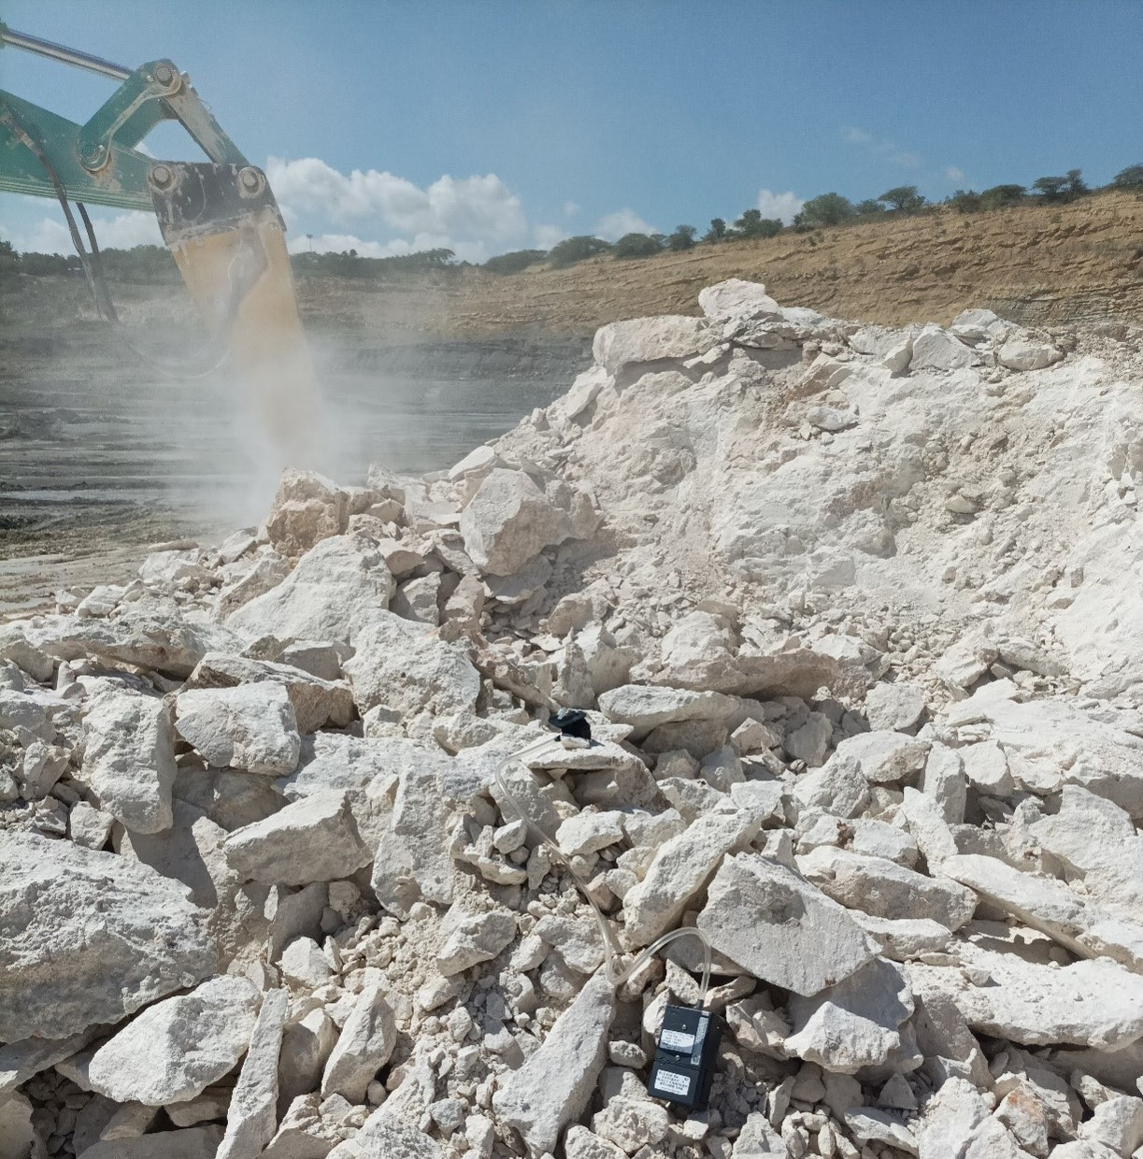
Result and Analysis-Domain 2
Respirable Dust
A total of 24 locations were selected for dust samples collection from four limestone mines, targeting the areas near dumper, shovel, and drill operators with 6 locations from each mine. All samples underwent analysis for crystalline silica content. The range of allowable dust concentration across the samples varied from 1.87 to 3.89 mg/m^3. Crystalline silica concentrations spanned from 0.035 to 0.234 mg/m^3, with percentages ranging from 1.87% to 6.02%.

Slide 28
For Haul Roads, dust concentrations ranged from 1.87 to 2.64 mg/m^3 and silica percentages varied from 1.83% to 7.27%. In the bottom pit near Excavators dust concentrations between 0.74 and 2.1 mg/m^3, and silica percentages from 2.49% to 2.86% are observed. Near Rock Breakers the highest variability in dust concentrations, ranging from 1.94 to 3.8 mg/m^3, with silica percentages from 2.44% to 4.21%.
Across all the mine samples, the average respirable dust concentration was 1.2 mg/m^3, the average crystalline silica concentration was 0.15 mg/m^3, and the average percentage of silica was 3.65%. Silica concentration of all samples remained below the maximum exposure limits prescribed by the Director General of Mines Safety (DGMS),but the respirable dust concentration across the rock braker slightly exceeded the limit.

Slide 29
Table 6.1: Dust Concentration
Locations | Dust Concentration (mg/m³) | Crystalline Silica Concentration (mg/m³) | Silica weight Percentage (%)
Haul Roads | 1.87 - 2.64 | 0.035 - 0.234 | 1.83 - 4.27
Bottom Pit (Excavators) | 0.74 - 2.1 | 0.035 - 0.234 | 2.49 - 2.86
Rock Breakers | 1.94 - 3.8 | 0.035 - 0.234 | 2.44 – 5.21

Slide 30
Volatile Organic Compound
We measured volatile organic compounds (VOCs) Concentration in four limestone mines across Tamil Nadu and identified seven specific VOCs in trace amounts:
Benzene: 5.6 - 6.1 µg/m³
Toluene: 25.4 - 27.0 µg/m³
m/p-Xylene: 6.3 - 7.2 µg/m³
o-Xylene: 2.7 - 4.3 µg/m³
Ethylbenzene: 1.6 - 1.7 µg/m³
1,2,4-Trimethylbenzene: 1.3 - 1.7 µg/m³
1,3,5-Trimethylbenzene: 1.4 - 1.5 µg/m³
This particular profile of VOCs is indicative of emissions from heavy machinery used in limestone mining operations.

Slide 31
Table 7.1: VOC Concentration
S.no | VOC | Abbreviation | Mine-1 Concentration (10⁻⁶ g/m³) | Mine-2 Concentration (10⁻⁶ g/m³) | Mine-3 Concentration (10⁻⁶ g/m³) | Mine-4 Concentration (10⁻⁶ g/m³)
1 | B | Benzene | 6.10 | 5.6 | 5.85 | 5.7
2 | T | Toluene | 25.40 | 27 | 26.2 | 26.6
3 | m/p-X | m/p - Xylene | 6.30 | 7.2 | 6.75 | 7.0
4 | o-X | o - Xylene | 2.70 | 4.3 | 3.5 | 3.9
5 | Eb | Ethylbenzene | 1.60 | 1.7 | 1.65 | 1.7
6 | 1,2,4-TMB | 1,2,4-Trimethyl, benzene | 1.30 | 1.7 | 1.5 | 1.6
7 | 1,3,5-TMB | 1,3,5-Trimethyl, benzene | 1.40 | 1.5 | 1.45 | 1.5

Slide 32
Summary of findings
Noise Exposure: Measured noise levels during various activities (drilling, blasting, crushing) had exceed safe exposure limits (typically 85 dB(A)). This highlights the need for noise control measures.
Dust Exposure: Analysis of dust composition identified potential respiratory risks associated with Silica dust around drilling operation.
Vibration Exposure: The assessment have identified potential risks of hand-arm vibration (HAV) associated with operating specific equipment.
VOC Exposure: Depending on the blasting materials and vehicle emissions, the project have revealed potential health risks associated with VOCs are negligible due to less concentration.

Slide 33
Conclusion
Noise Exposure: Hearing protection (earplugs/earmuffs) mandatory to reduce noise below 85 dB(A).
Dust Inhalation: Dust masks or respirators required depending on dust composition (silica needs stronger filtration).
Hand Protection: Gloves needed for specific tasks to protect from vibration, cuts, or chemicals.
Noise Reduction: Implement quieter equipment, enclosures, or sound dampening materials.
Work Schedule: Rotate workers to minimize high-noise area exposure.
Hearing Health: Regular hearing checks and proper PPE use training.

Slide 34
Future Scope
Advanced Dust Characterization: While the project identified potential respiratory risks from dust exposure, future studies could delve deeper into the specific particle size distribution and mineralogical composition of the dust. This information can help identify more targeted dust control methods and assess potential health risks associated with specific dust components like silica.
Heat Stress Evaluation: Working in hot and humid environments is a concern in many limestone mining regions. Future assessments could evaluate heat stress risks by monitoring environmental conditions and worker core body temperature. This would allow for the development of appropriate heat stress mitigation strategies like hydration protocols, cooling methods, and work scheduling adjustments.

Slide 35
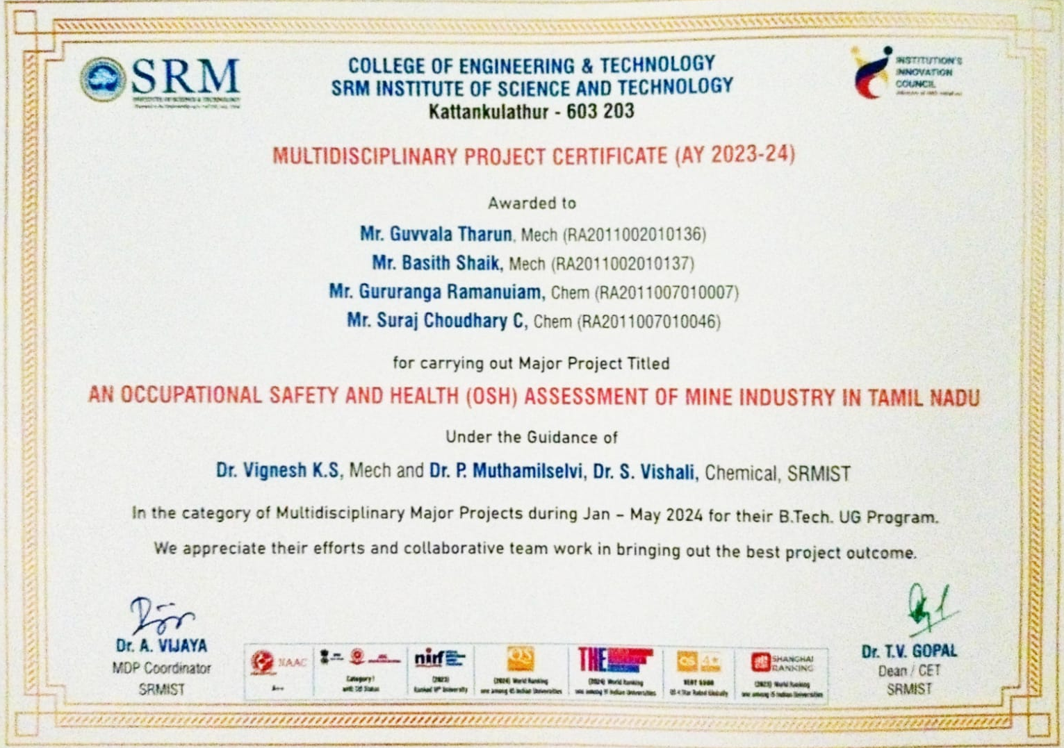
Project Outcome ( Proof for Conference Presentation/ Paper Publication/Patent filing)

Slide 36
References
Priyanka Mankar: Monitoring and Assessment of Airborne Respirable Dust and Free Silica Content in an Indian Mine Publication: J Health Pollution (June 13 2019) GOOGLE SCHOLAR
Wang H L, Nie L, Li J, et al. Characterization and assessment of volatile organic compounds (VOCs) emissions from typical industries. Chin Sci Bull, 2013, 58: 724−730, Doi: 10.1007/s11434-012-5345-2.
. Amit Kumar, Deepak Singh, Krishan Kumar, Braj Bihari Singh, Vinod Kumar Jain, Distribution of VOCs in urban and rural atmospheres of subtropical India: Temporal variation, source attribution, ratios, OFP and risk assessment, Science of The Total Environment.
Dharas, Nandi S. Assessment of silica dust exposure profile in relation to prevalence of silicosis among Indian sandstone workers: Need for review of standards.
Nasirul, F., Stem, E. Whole-Body Vibration in the Mining Industry: A Systematic Review of Assessment.
Indian Minerals, Yearbook 2020 (Part-III: Mineral Reviews), Edition: 59, Limestone & Other Calcareous Materials (Advance Release). • Priyanka Mankar: Monitoring and Assessment of Airborne Respirable Dust and Free Silica Content in an Indian Mine Publication: J Health Pollution (June 13 2019) GOOGLE SCHOLAR
Wang H L, Nie L, Li J, et al. Characterization and assessment of volatile organic compounds (VOCs) emissions from typical industries. Chin Sci Bull, 2013, 58: 724−730, Doi: 10.1007/s11434-012-5345-2.

